Slide 1
Bitcoin Transaction Analysis
Prof Dr. Weider Yu
By : Shivam Kumar Gupta Tanay Rashinkar
Rovin Singh Patwal Vinayak Nigam

Slide 2
Problem Statement
As cryptocurrency are accepted widely in the society for transaction of various things, there is a need for small and big enterprise to adapt to Cryptocurrency transaction Standards.
We decided to connect to Bitcoin core server and store all the transactions as happening live and store them for later use.
We also included API’s to get the wallet balance and transaction search in our use cases.
As we store more and more transaction in the Dynamo DB we can provide more API’s and search results.

Slide 3
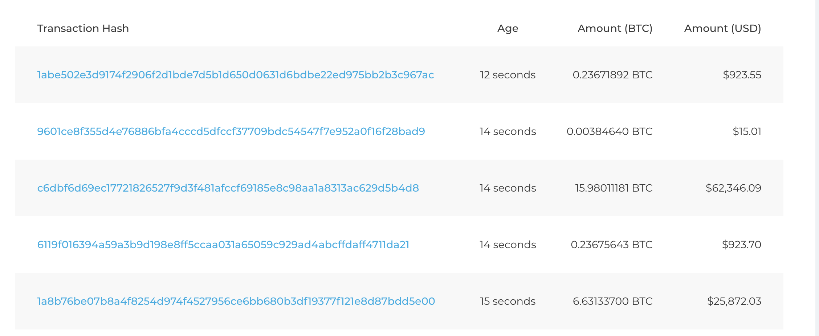
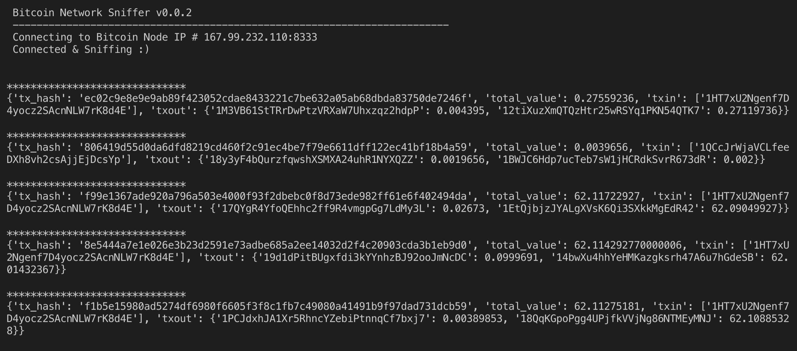
Incoming Transaction.
The transaction and extracted by connecting to bitcoin Core server, and stored in the Dynamo DB database. The transaction are showed live in the Dashboard.

Slide 4
Api for Wallet Balance check and Block Information.
1. Create New wallet.
URL: http://localhost:3000/api/v2/create
Response:
{ "guid": "4b8cd8e9-9480-44cc-b7f2-527e98ee3287", "address": "12AaMuRnzw6vW6s2KPRAGeX53meTf8JbZS", "label": "Main address" }

